Slide 1


Building a Scalable WordPress Architecture using Infrastructure as Code
Heiko Graceffa - AWS Cloud Computing
Capstone Project 09.12.2025

Slide 2
Agenda
Problems & Requirements
AWS Solution Architecture
About the AWS-Services
Infrastructure as Code (IaC): Terraform
Deployment Workflow
Result
Q&A

Slide 3






Problems & Requirements
Manual steps are error-prone
Hard to scale or reproduce
No seperation between web server and Database
Need a modern, automated WordPress solution
Should use scalable AWS services
Must be secure, repeatable, and cloud-native

Slide 4


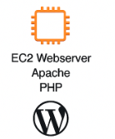


AWS Solution Architecture
AWS Cloud
VPC
10.0.0.0/16
AZ 1
AZ 2
Public subnet
10.0.1.0/24
Private subnet A
10.0.2.0/24
Private subnet B
10.0.3.0/24

Slide 5


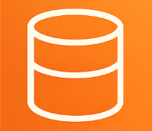
About the AWS-Services
Amazon VPC to provision a logically isolated network environment for all resources
Amazon EC2 as a scalable compute service to deploy the WordPress webserver with Internet Gateway access
Amazon RDS to provide a managed and highly available MariaDB database that is not publicly accessible
Security Group to control traffic: allow HTTP/SSH only to the EC2 instance and allow MySQL access only from EC2

Slide 6




Infrastructure as Code (IaC): Terraform
Terraform as IaC for WordPress project that automates and mange the infrastructure more effectively.
Declaration of variables, in varaibles.tf files can be used in .tf files and can contain sensitive Information that can be written in the terraform.tfvars file
variables.tf
VPC + Subnets created with .tf files
Security groups defined declaratively
EC2 configured in a user_data.sh
RDS created in Multi-AZ Mode
Automatic insertion of RDS endpoint into WordPress config
main.tf
terraform.tfvars

Slide 7
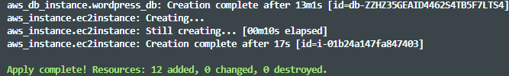
Deployment Workflow
CI-like pipeline:
terraform init
terraform plan
terraform apply
EC2 user-data auto-installs WordPress
EC2 connects to RDS automatically

Slide 8
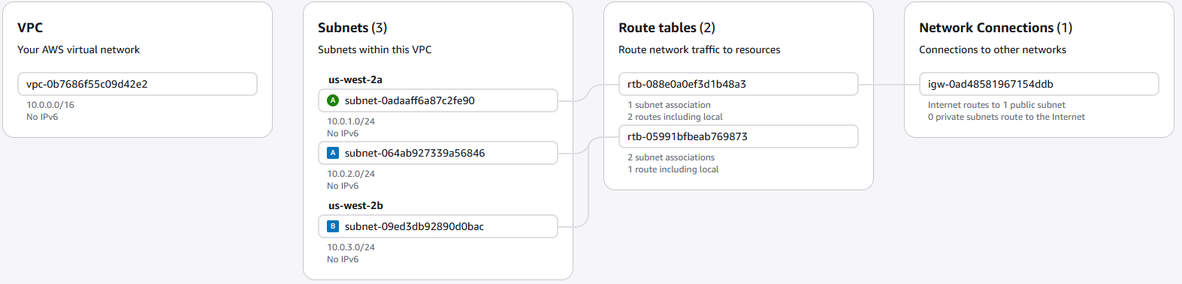
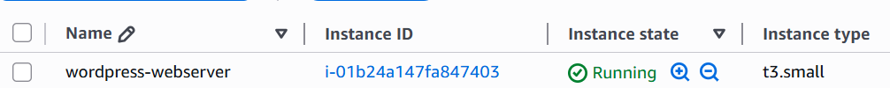
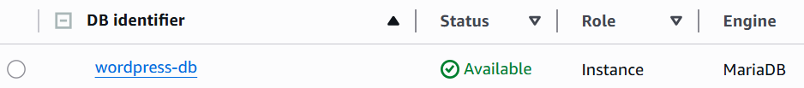
Results
EC2 webserver is running in the public subnet
RDS MariaDB instance is available in private subnets (Multi-AZ)
VPC networking configured correctly (IGW, subnets, route tables)
Proper separation between web server and database
All AWS resources provisioned automatically using Terraform

Slide 9
Questions?

